Slide 1

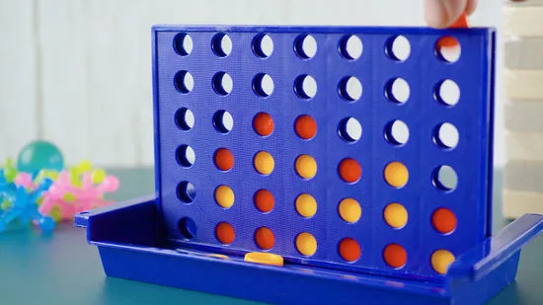
CONNECT FOUR
CMPE 260 - PROJECT PRESENTATION
Abhishek Bais, Haley feng, princy joy, Shannon phu
Graduate students software engineering, SJSU

Slide 2

OUTLINE
The GAME
Problem Statement
Motivation
Methodology
Results
Demo

Slide 3
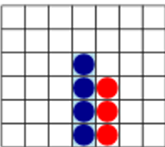
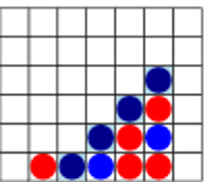
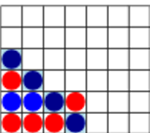
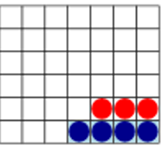
THE GAME
Connect Four is a popular two player game
Each player takes turns to drop a selected colored piece in a 6x7 grid
First player to form a 4-in-row connection wins
4-IN-ROW VERTICAL
4-IN-ROW DIAGONAL
4-IN-ROW DIAGONAL
4-IN-ROW HORIZONTAL

Slide 4
PROBLEM STATEMENT
SIMULATE A REAL-LIFE CONNECT FOUR GAMING EXPERIENCE FOR A HUMAN PLAYER AGAINST A COMPUTER AGENT
TRAIN REINFORCEMENT LEARNING GUIDED COMPUTER AGENTS, IMPLEMENTING THE FOLLOWING ALGORITHMS TO PLAY THE GAME VIA BATTLES AGAINST A COMPUTER AGENT THAT MAKES RANDOM MOVES AND VIA BATTLES AGAINST A GAME THEORY GUIDED COMPUTER AGENT
Minimax Algorithm (Game Theory Guided Agent)
Monte Carlo Algorithm (Reinforcement Learning Guided Agent)
Q Learner Algorithm (Reinforcement Learning Guided Agent)
Sarsa Learner Algorithm (Reinforcement Learning Guided Agent)
COMPARE AND CONTRAST THE PERFORMANCE OF THE REINFORCEMENT LEARNING GUIDED COMPUTER AGENTS ON WIN-RATE AND EFFICIENCY (AVERAGE PLAY TIME)

Slide 5
MOTIVATION
MODEL AN INTERMEDIATE COMPLEXITY (6X7 BOARD GAME)
MOST EXISTING REINFORCEMENT LEARNING MODELS IN THE GAMING CONTEXT ARE FINE-TUNED TO TIC-TAC-TOE (A SIMPLISTIC 3X3 BOARD GAME WITH A SMALL STATE SPACE) OR ALPHA-GO (A PROGRAM THAT PLAYS GO, A 19X19 BOARD GAME AFTER STORING 30 MILLION POSITIONS)
PROVIDE INSIGHTS INTO HOW REINFORCEMENT LEARNING GUIDED COMPUTER AGENTS PERFORM IN BATTLES AGAINST A COMPUTER AGENT THAT MAKES RANDOM MOVES AND IN BATTLES AGAINST A COMPUTER AGENT THAT USE MINIMAX (A BACKTRACKING, RECURSIVE GAME THEORY ALGORITHM) IN TERMS OF WIN RATE AND EFFICIENCY

Slide 6
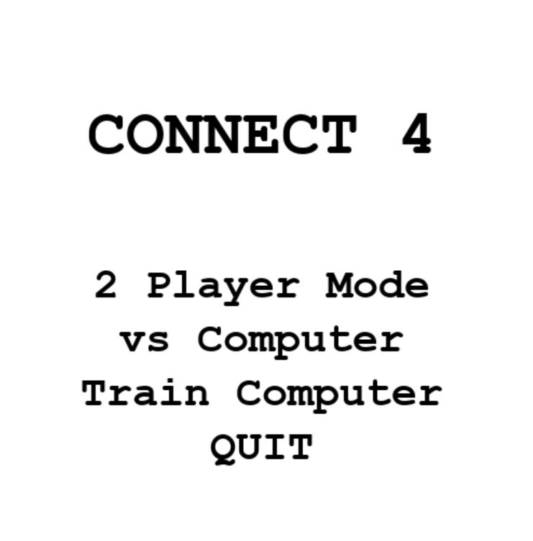
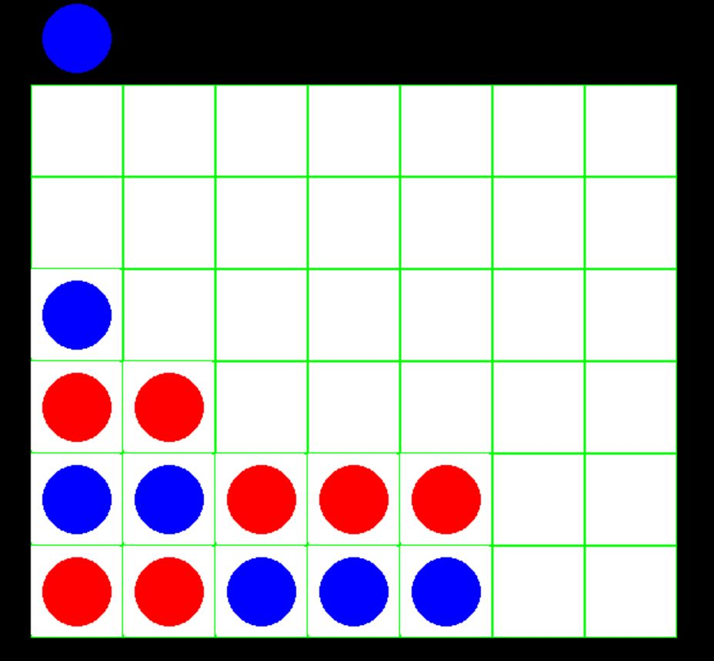
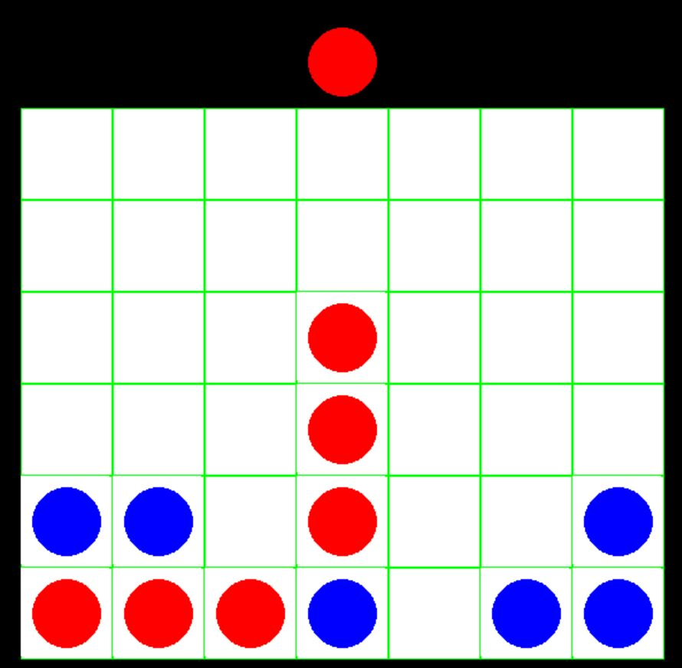
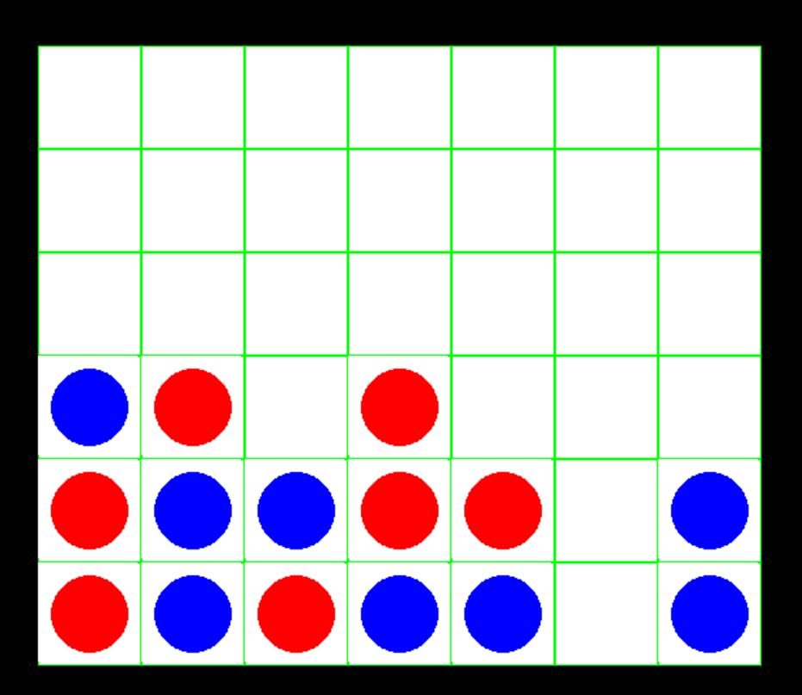

METHODOLOGY – GAME SETUP
THE GAME IS SETUP TO BE PLAYED IN THREE MODES
MODE 1 - Single Player Mode (Human Player vs Computer Agent)
MODE 2 - Two Player Mode (Human Player vs Human Player)
MODE 3 - Training Mode (Reinforcement Learning Guided Computer Agent battles against a Computer Agent that makes random moves and a Game Theory guided Computer Agent over N iterations and learns to play the game)
MODE1: Single Player Mode
MODE 2: Two PLAYER Mode
MODE 3: Training Mode

Slide 7
METHODOLOGY - ALGORITHMS
FOUR DIFFERENT ALGORITHMS WERE IMPLEMENTED TO MODEL THE COMPUTER AGENTS
MINIMAX AGENT
USES A BACKTRACKING, RECURSIVE ALGORITHM USED IN GAME THEORY TO MAKE MOVES THAT RESULT IN MAXIMUM IMMEDIATE GAIN
MONTE CARLO AGENT
USES REINFORCEMENT LEARNING TO LEARN DIRECTLY FROM GAME EXPERIENCES WITHOUT USING ANY PRIOR MARKOV DECISION PROCESS KNOWLEDGE
Q LEARNING AGENT
USES A REINFORCEMENT LEARNING OFF-POLICY VALUE BASED SCHEME BASED ON THE BELLMAN’S EQUATION TO LEARN THE VALUE OF OPTIMAL POLICY REGARDLESS OF ACTION
SARSA LEARNING AGENT
USES A REINFORCEMENT LEARNING ON-POLICY VALUE BASED SCHEME TO LEARN THE VALUE OF THE OPTIMAL POLICY BASED ON ACTION DERIVED FROM CURRENT POLICY
DURING TRAINING, THE REINFORCEMENT LEARNING GUIDED COMPUTER AGENTS BATTLE AGAINST A COMPUTER AGENT THAT MAKES RANDOM MOVES AND AGAINST A GAME THEORY GUIDED COMPUTER AGENT OVER N ITERATIONS, RESULTS ARE EVALUATED FOR WIN-RATE AND EFFICIENCY (AVG PLAY TIME)

Slide 8
METHODOLOGY – HYPER PARAMETER TUNING
ALGORITHM | HYPER PARAMETERS TUNED
Q LEARNING | alpha - [ learning rate, tuning exp 0.05, 0.25, 0.3, 0.75, 0.9 ] gamma - [ discount factor, tuning exp 0.25, 0.50, 0.75, 0.9, 0.98 ]
SARSA LEARNING | alpha - [ learning rate, tuning exp 0.05, 0.25, 0.3, 0.75 ] gamma - [ discount factor, tuning exp 0.25, 0.50, 0.75, 0.9, 0.98 ]
MONTE CARLO | exploration coefficient - [ tuning exp 0.8, 1, 1.4, 1.6 ]
MINIMAX | Depth of recursion - 0.5
QLEARNER, SARSA LEARNER AGENTS – ARE FIRST TUNED FOR “LEARNING RATE” THEN TUNED FOR “DISCOUNT FACTOR” ON TOP

Slide 9
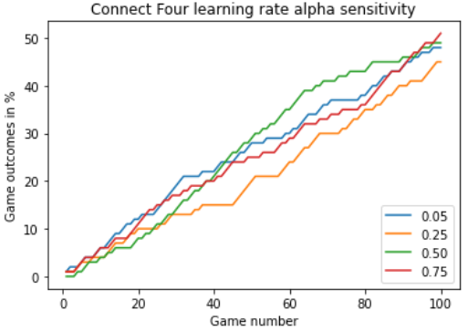
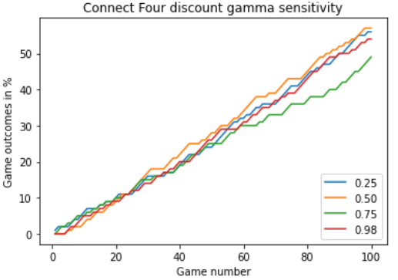
RESULTS – SENSITIVITY ANALYSIS OF QLEARNER AGENT
ALPHA/ LEARNING RATE (lr) SENSITIVITY ANALYSIS
For very lr = 0.05 learning happens rapidly initially then becomes more gradual
For moderate lr = 0.50 learning happens gradually initially, then picks up to beat others [ best ]
For high lr = 0.75 learning happens rapidly initially then slower than very lr
GAMMA/ DISCOUNT FACTOR SENSITIVITY ANALYSIS
For low, moderate gamma = [0.25, 0.50] learning happens rapidly, highest win-rate [ best ]
For high gamma = 0.75 learning happens gradually
For very high gamma = 0.98 learning happens gradually initially then slows down

Slide 10
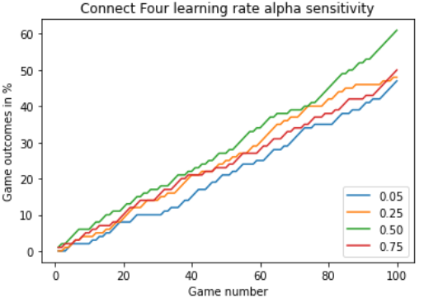
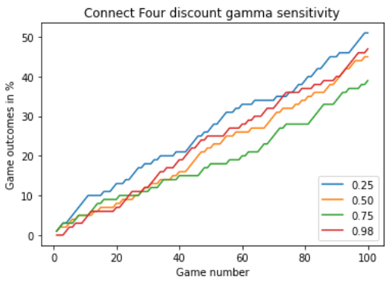
RESULTS – SENSITIVITY ANALYSIS OF SARSA LEARNER AGENT
ALPHA/ LEARNING RATE (lr) SENSITIVITY ANALYSIS
For very lr = 0.05 learning happens slowest
For low, moderate lr = [0.25, 0.50] learning happens gradually initially, then picks [ best ]
For high lr = 0.75 learning happens gradually, slower than low, moderate lr
GAMMA/ DISCOUNT FACTOR SENSITIVITY ANALYSIS
For low gamma = 0.25 learning happens rapidly, highest win-rate [ best ]
For moderate, very high gamma = [0.50, 0.98] learning happens gradually, slower than low gamma
For high gamma = 0.75 learning happens the slowest

Slide 11
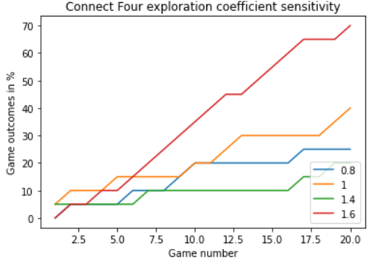
RESULTS – SENSITIVITY ANALYSIS OF MONTE CARLO AGENT
EXPLORATION COEFFICIENT [ HOW MUCH MONTE CARLO TREE TO SEARCH ] SENSTIVITY ANALYSIS
Smaller Exploration Coefficient values lead to greater exploitation i.e., visited nodes are revisited
Large Exploration Coefficient values lead to greater exploration i.e., new nodes are visited
For exploration coefficient = 1.6, learning happens rapidly with high win-rate [ best ]

Slide 12

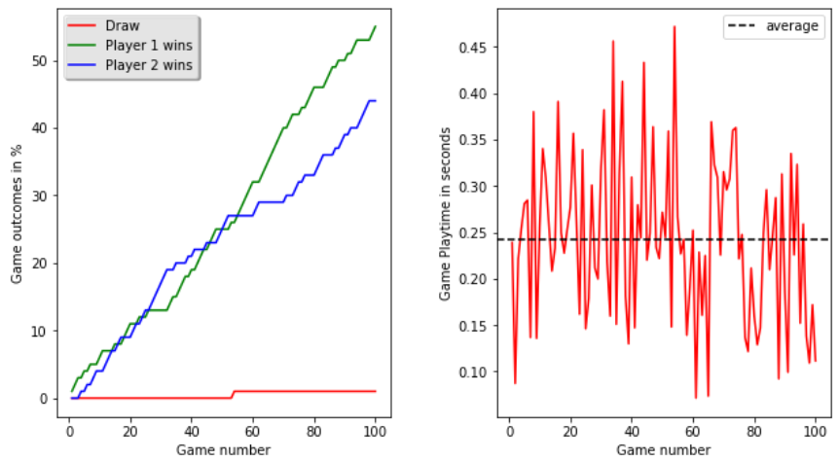
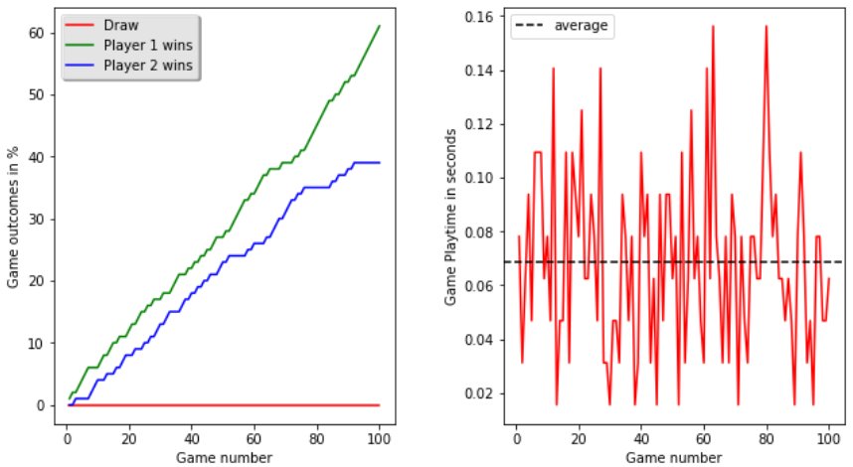
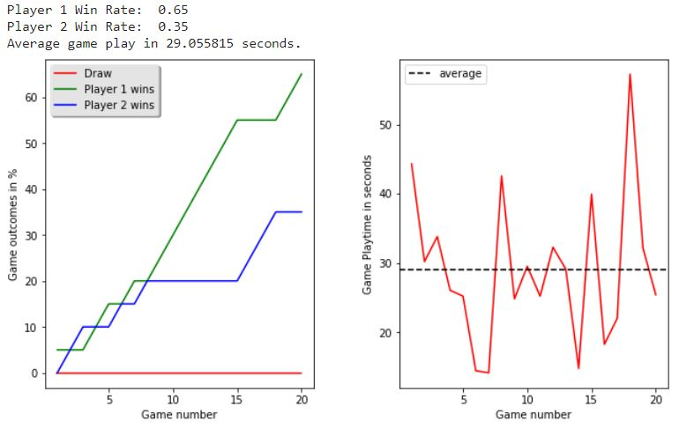
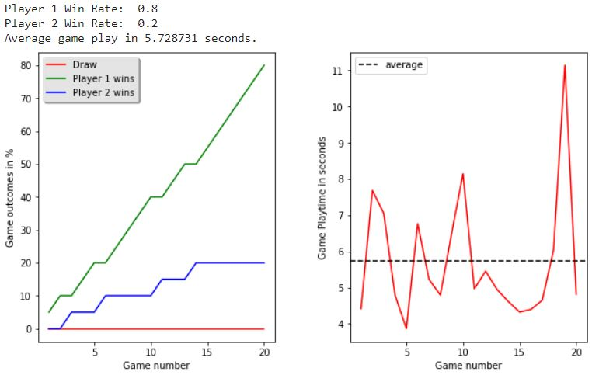
RESULTS – COMPUTER AGENTS VS RANDOM MOVE COMPUTER AGENT WIN RATE
QLEARNER VS RANDOM MOVE AGENT
Win Rate 55%
SARSA LEARNER VS RANDOM MOVE AGENT
Win Rate 61%
MONTE CARLO VS RANDOM MOVE AGENT
Win Rate 65%
MINIMAX VS RANDOM MOVE AGENT
Win Rate 80%
MINIMAX has the highest Win Ratio = 80% in 20 battles vs RANDOM MOVE Agent

Slide 13
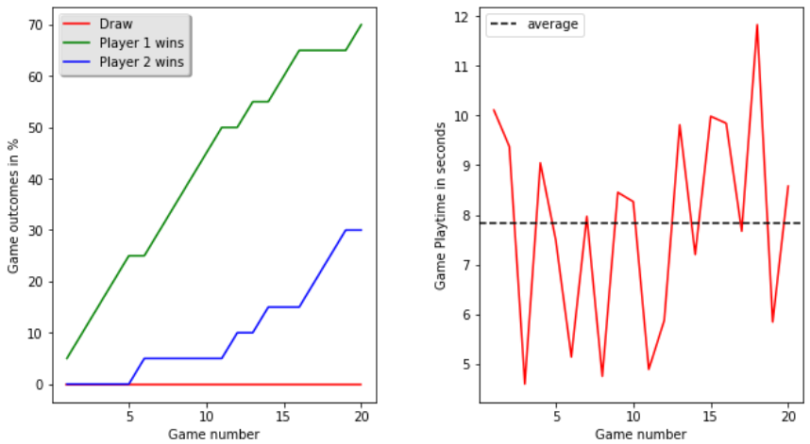
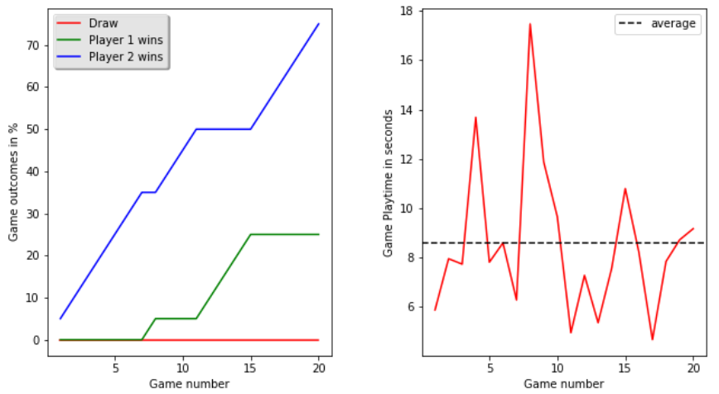
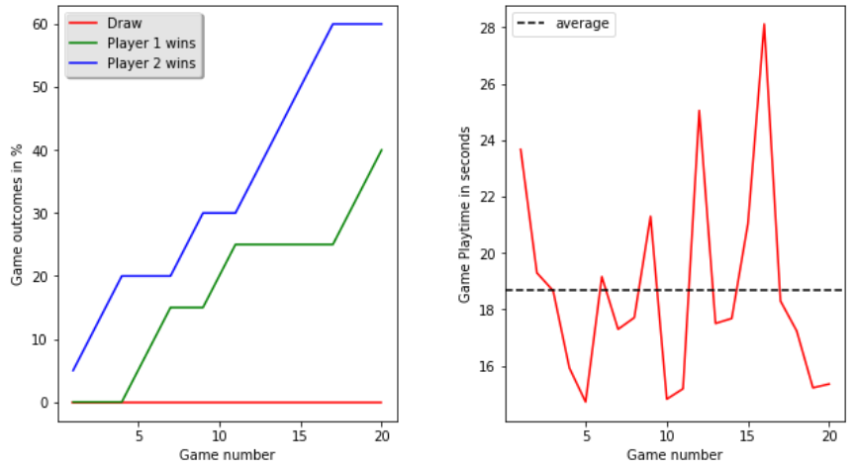
RESULTS – RL GUIDED COMPUTER AGENTS VS MINIMAX AGENT WIN RATE
MINIMAX (Player 1) vs
Q LEARNER (Player 2)
QLEARNER Win Rate 30%
MINIMAX (Player 1) vs
SARSA LEARNER (Player 2)
SARSA LEARNER Win Rate 75%
MINIMAX (Player 1) vs
MONTE CARLO (Player 2)
MONTE CARLO Win Rate 60%
SARSA LEARNER has the highest Win Ratio = 75% in 20 battles vs MiniMax Agent

Slide 14
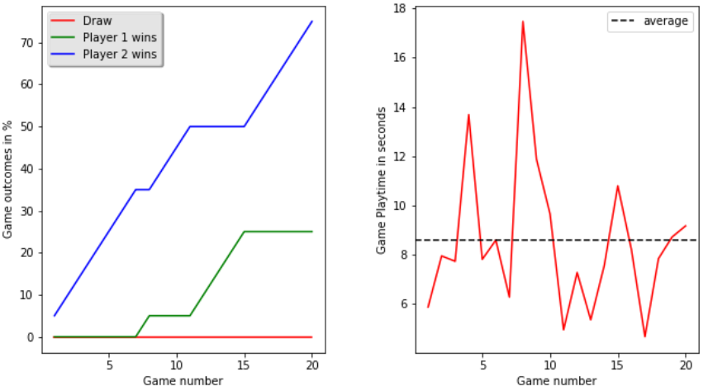
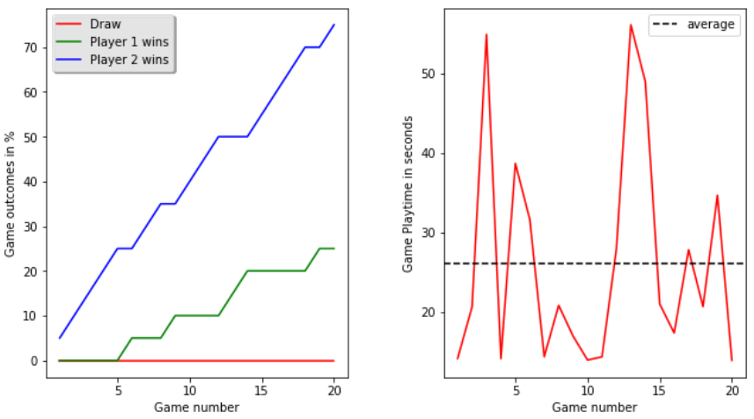
RESULTS – WIN RATE COMPARISON
WIN RATE COMPARISON
BEST OVERALL WORST OVERALL BEST IN COLUMN | VS BASELINE AGENTS |  | VS RL GUIDED COMPUTER AGENT |  |  | Overall Avg Win Rate
 | Random Move | Minimax (80%-win rate vs Random Move) | Q LEARNER | SARSA LEARNER | MONTE CARLO
Q LEARNER | 0.55 | 0.30 | NA | 0.44 | 0.35 | 0.41
SARSA LEARNER | 0.61 | 0.75 | 0.55 | NA | 0.75 | 0.665
MONTE CARLO | 0.65 | 0.60 | 0.65 | 0.25 | NA | .5475
MINIMAX (Player 1) vs
SARSA LEARNER (Player 2)
SARSA LEARNER Win Rate 75%
RL GUIDED COMPUTER AGENT VS BASELINE AGENTS
SARSA LEARNER HAS HIGHEST WIN RATE OF 75% VS MINIMAX AGENT
RL GUIDED COMPUTER AGENT VS RL GUIDED COMPUTER AGENTS
SARSA LEARNER HAS THE HIGHEST WIN RATE OF 75% VS MONTE CARLO
MONTE CARLO (Player 1) vs
SARSA LEARNER (Player 2)
SARSA LEARNER Win Rate 75%

Slide 15
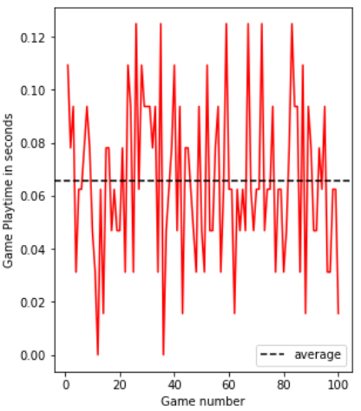
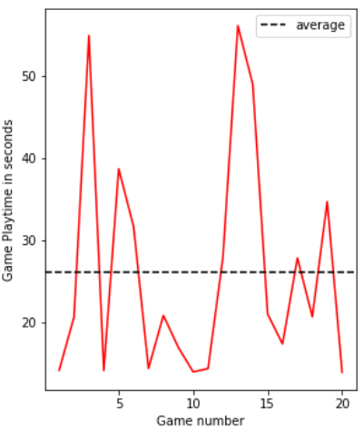
RESULTS – EFFICIENCY COMPARISON
SPEED COMPARISON
FASTEST SLOWEST | VS BASELINE AGENTS |  | VS RL GUIDED COMPUTER AGENT
 | Random Move | Minimax (80%-win rate vs Random Move) | Q LEARNER | SARSA LEARNER | MONTE CARLO
Q LEARNER | 0.2422 | 7.835 | NA | 0.0634 | 24.138
SARSA LEARNER | 0.0681 | 8.575 | 0.0634 | NA | 26.117
MONTE CARLO | 29.055 | 18.661 | 24.138 | 26.117 | NA
SARSA
RL GUIDED COMPUTER AGENT VS BASELINE AGENTS
SARSA LEARNER IS FASTEST, AVG PLAY TIME OF 0.06s VS RANDOM MOVE AGENT
MONTE CARLO IS SLOWEST, AVG PLAY TIME OF 29.06s VS RANDOM MOVE AGENT
RL GUIDED COMPUTER AGENT VS RL GUIDED COMPUTER AGENTS
SARSA LEARNER IS FASTEST, AVG PLAY TIME OF 0.0634s VS Q LEARNER AGENT
MONTE CARLO IS SLOWEST, AVG PLAY TIME OF 26.117s VS SARSA LEARNER AGENT
MONTE
CARLO

Slide 16

GITHUB REPO

